Slide 1
Leadership Models/Theories/Styles
Leadership style is the manner and approach of providing direction, implementing plans, and motivating people.
As seen by the employees, it includes the total pattern of explicit and implicit actions performed by their leader (Newstrom, Davis, 1993).

Slide 2
Types of Leadership Theories
Democratic Leadership.
Autocratic Leadership.
Laissez-Faire Leadership.
Strategic Leadership.
Transformational Leadership.
Transactional Leadership.
Situational Leadership
Bureaucratic Leadership.

Slide 3
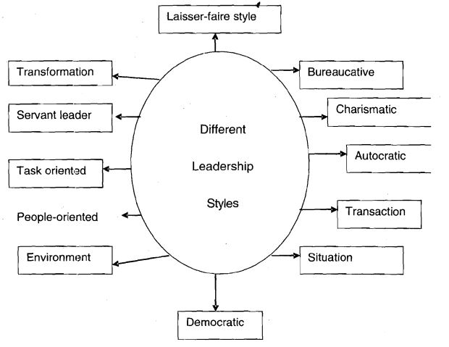
Leadership Theories

Slide 4
Lewin’s Leadership Types: On the basis of decision making Autocratic vs Democratic vs Laissez Faire
Autocratic leaders make all the decisions themselves. They do not consult their team, or let them make decisions. Once the decision has been made, they impose it and expect obedience.
Laissez-faire leaders have very little involvement in decision-making, mostly leaving everything up to their team. As long as the team members are capable and motivated this can work, but can create problems if not.
Democratic leaders take an active role in the decision-making process but they involve others. They carry the responsibility for seeing that the decisions made achieve the desired outcomes.

Slide 5
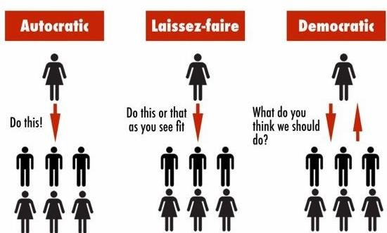
Autocratic vs Democratic vs Laissez- faire

Slide 6
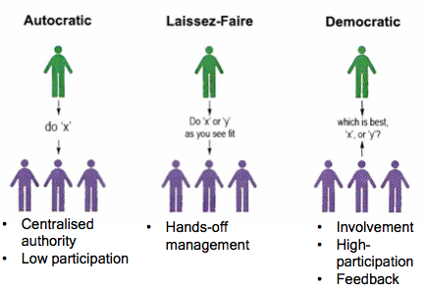
Autocratic vs Democratic vs Laissez- faire

Slide 7
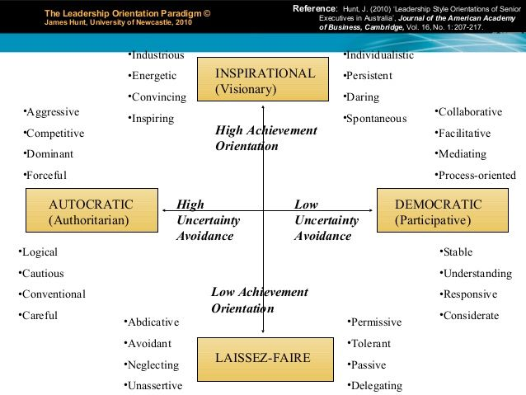
4 leadership types: comparison

Slide 8

Leadership types: want to listen?

Slide 9
Discussion: Interaction
Your perceptions: have your say.

